Slide 1
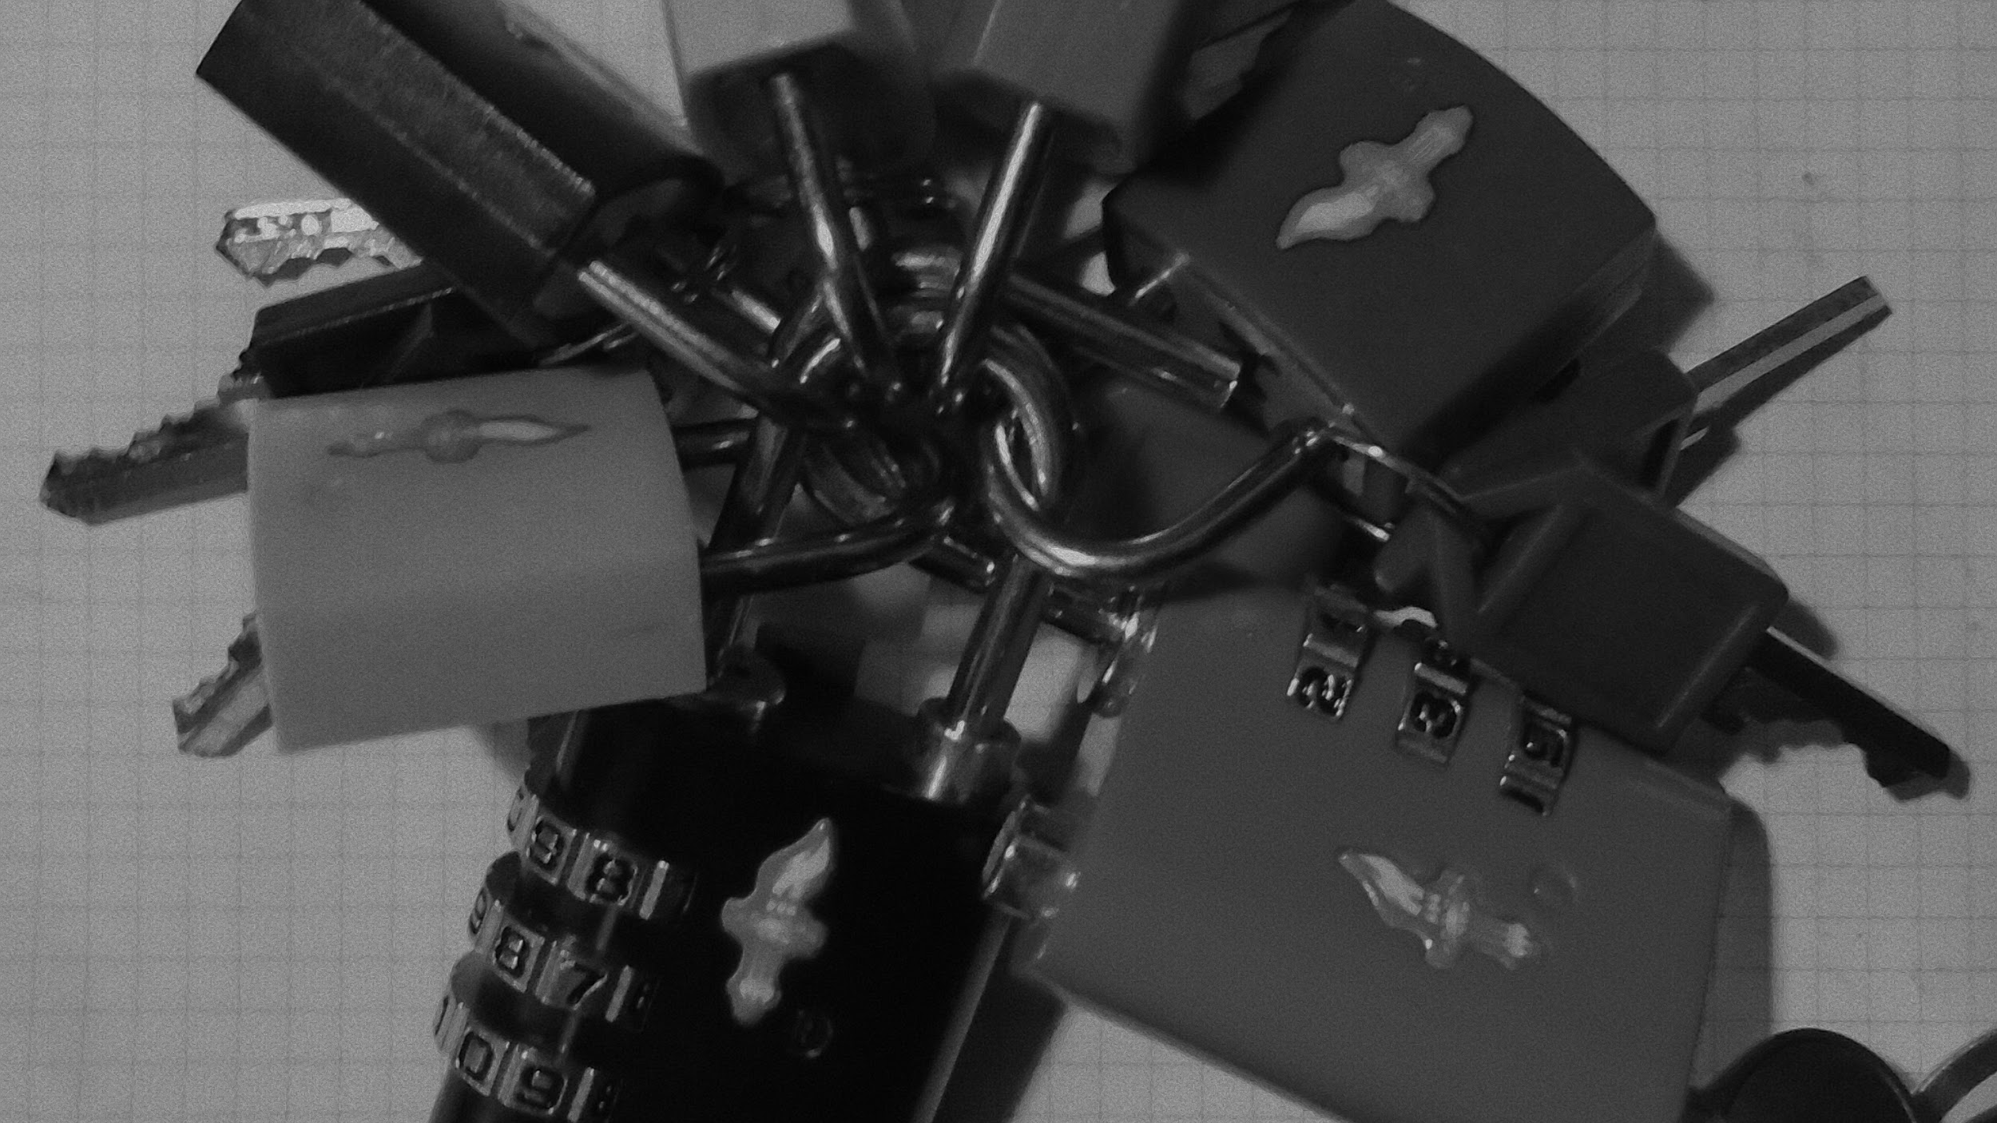
TSA Locks and key escrow:
Now I have a machine gun!
Ho ho ho!
Notes:
Is projector 4×3 or 16×9
“The weaknesses that allowed me to undermine TSA locks«line break»from the comfort of my living room”
Chubbier font for visibility at distance
-Trying to maintain the look of Dr. Strangelove’s opening without paying $20 for a non-portable font license.

Slide 2
Disclaimers
This ███████ presentation █████ not endorsed ████████ has nothing to do ███████ ████ current DHS/TSA, ████ or █████ ███████ ██ █ ████ █ ██ ███ ████ █ ████████
███████ ████ █████ ██ █ ████ ███ ████████ ███████████
███ comments █ opinions expressed herein are ██ ███ and NOT those of ██ ████████ or ███████████ or ██ █ ████ █ ████████.
███████ WE ████ ARE NOT █████ ██ █ ████ █ ████████ LAWYERS ███████████
Use at your own risk
Not responsible for death, ██████████ ██ ████████ lawyers, dismemberment, ████ █████ ██ █ ████ ███ ████████, acts of war, acts of deities, acts of ████ ██ ████ in warzones, ████ █ ████████, loss of █████ ██ ████, dry mouth
Not appropriate for children under 6” tall, small parts present a choking hazard to those lacking object permanence
We are not responsible for your poor decision making
Call before you dig
If Frog begins to emit a 2600 HZ tone, deposit Frog in nearest AT&T phone booth
Do ███ try this at home
Not affiliated with the University of Florida or any other institution of higher learning
Reference herein to any specific commercial products, process, or service by trade name, trademark, manufacturer, or otherwise, does not necessarily constitute or imply its endorsement, recommendation, or favoring by us or competence by the United States Government
The user takes full responsibility for everything and anything that could and/or does go wrong resulting in any kind or type of problem, difficulty, embarrassment, loss of money or goods or services or sleep or anything else whatsoever
Notes:
Disclaimers inspired by Mudge, Steve martin, silly legal boilerplate.
Number 5 and 9 are particularly important.

Slide 3
Yet More Disclaimers (you thought you were free)
Unless the word absquatulation has been used in its correct context somewhere other than in this warning, it does not have any legal or grammatical use and may be ignored
No animals were harmed in the creation of this presentation, one of you will accuse us of this regardless
Those of you with an overwhelming fear of the unknown will be gratified to learn that there is no hidden message revealed by reading this warning backwards
████ ██ ███ and NOT those of ██ ████████ or ███████████ or ██ █ ████ █ ████████
You are advised that urgent, time sensitive and confidential communications should not be sent by e-mail. You agree that you will not use e-mail correspondence for unlawful purposes or in contravention of Laws on electronic communications
This presentation is intended for the use of the individual attendees in the audience and may contain information that is confidential, privileged or unsuitable for overly sensitive persons with low self-esteem, no sense of humour or irrational religious beliefs, any dissemination, distribution or copying of this slide deck is ███ authorised (either explicitly or implicitly or ███████████) and constitutes an irritating social faux pas
███████ WE STILL ████ ARE NOT █████ ██ █ ████ █ ████████ LAWYERS ███████████
We do not endorse any activity or recommend it to any particular person - we simply describe our experiences and opinions; If you choose to engage in these activities it is by your own free will and at your own volition
Use your brain and common sense when engaging in any activity or making any modifications
Remember: Safety first, always use common sense; Never do more than you are comfortable with; Always wear safety belts and use all appropriate safety equipment
Notes:
Disclaimers inspired/stolen from the winners of El Reg’s 2001 DAFTAs

Slide 4
What are TSA Approved locks?
Introduced to address TSA policy of destructively opening locked luggage for screening in 2003
Proprietary systems with little public information for review
Designed to be opened with one of several “master” keys provided to the TSA, customs, law enforcement, etc (both US and foreign agencies) - a form of key escrow
May be keyed (owner gets a key that operates the lock) or combination (owner receives no key)
Two competing standards (Travel Sentry and Safe Skies)
Notes:
Skim over this (1-2 minutes total for TSA approval)
Introducing basic concepts and players
Transportation Security Act required TSA to be able to physically screen all checked bags by 2003. TSA announced that it would begin clipping locks or otherwise forcibly open any locked bags on January 1, 2003 to meet this requirement. Obviously travelers were less than thrilled.

Slide 5

What are TSA Approved locks?
Travel Sentry sets standards for the override keys and mechanisms then licenses those standards to “hundreds” of manufacturers
Dominant standard in the consumer market
Currently offers 7 known override keys numbered as TSA001-TSA007
Travel Sentry ®, an organization that provides security solutions to the travel industry, announced today a new baggage locking system that allows airline passengers to lock their bags without interfering with the Transportation Security Administration's (TSA) need to open bags for inspection.
...
"TSA is ready to work with any industry in developing practical solutions that contribute toward our goal of providing world-class security and world-class customer service," said Ken Lauterstein, Program Manager for Checked Baggage Screening Operations in TSA's Office of Aviation Operations.
12 November 2003 - http://www.travelsentry.org/en/press-release/2003/pr-12-november.php
(Remember these quotes for later)
Notes:
Player 1 has joined

Slide 6
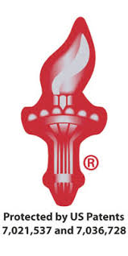
What are TSA Approved locks?
Safe Skies manufactures locks under their own competing standard
Only offers a single override key (labeled as TSA Safe Skies)
Has sued Travel Sentry for patent infringement
Smaller market share than Travel Sentry
All available information indicates only one override/master key for their entire system
Notes:
Player 2 joins, contrast with Player 1

Slide 7
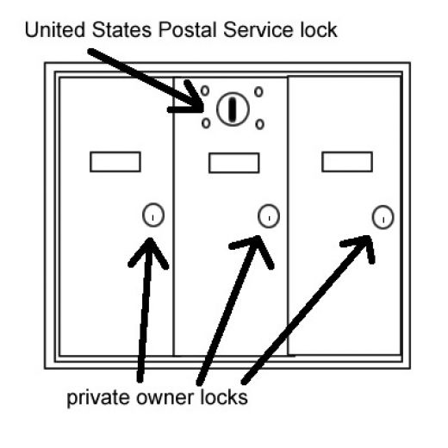
What is Key Escrow?
owner/users gets an access token
3rd party (typically Gov’t) get a separate access token held in ‘escrow’
3rd party is only allowed to use escrowed token under specific situations
USPS multi-dwelling unit mailboxes work on this principle
Proper function requires 3rd party complies with the rules
USPS lock gives letter carrier access to all boxes, owner locks give access to individual boxes.
image source: http://hubpages.com/living/USPS-Approved-Mailboxes---FAQ
Notes:
Skim some more. 3 sentences.

Slide 8
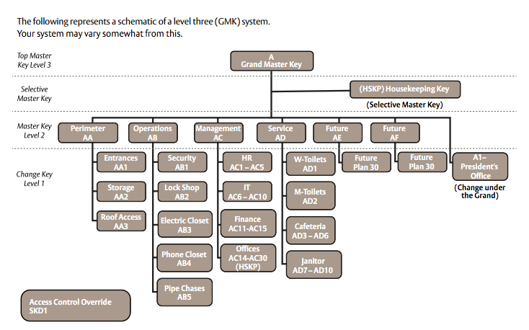
Master Keys
It can get complicated quickly (also, really expensive)
Notes:
Background for the lock-novices.
Mention expense, complexity (mechanical and administrative) , and cost of incident response.

Slide 9
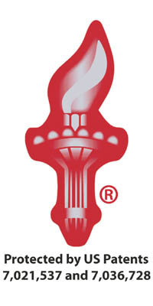

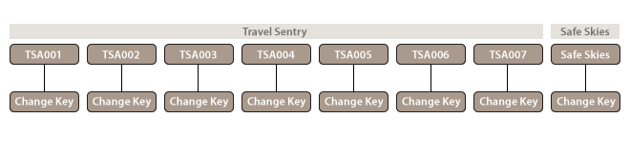
The TSA went for something a bit simpler
Less simple, slightly more secure.
We now have 8 master keys to compromise but, a bad (internal) actor can still grab them on a single keyring.

Slide 10
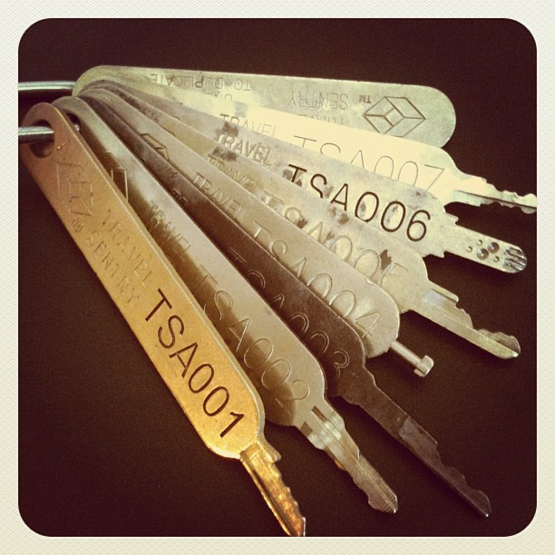
Travel Sentry key compromise
Travel Sentry and the TSA are bad at data classification and key escrow security.
2011
©Ryetronics on Instagram
Notes:
5-9 should be delivered rapidly to emphasize the stupid leaks
Needs a fanned-out, dropped picture touch. The more, the merrier.

Slide 11
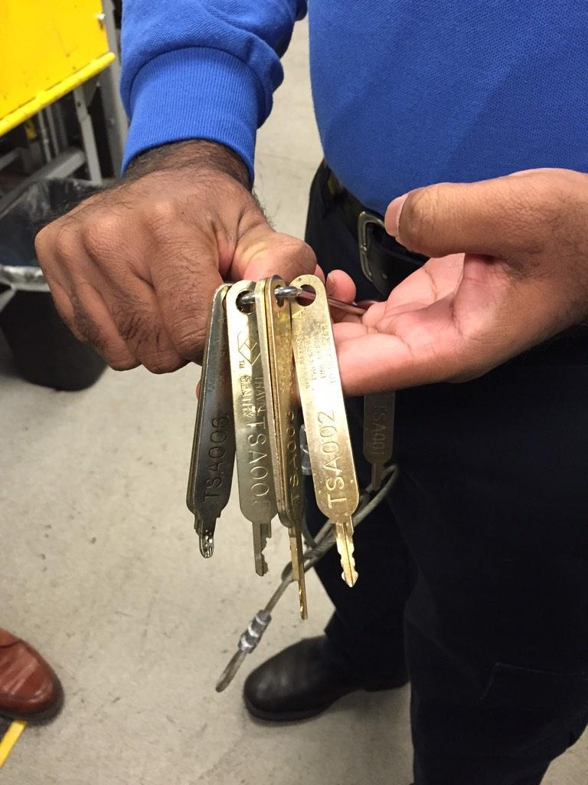
Travel Sentry key compromise
Travel Sentry and the TSA are bad at data classification and key escrow security.
2011
©Ryetronics on Instagram
2014
©Scott Mayerowitz @GlobeTrotScott
Notes:
Sources! Sources! Sources!
-Trying. These things have circulated so damn much...

Slide 12
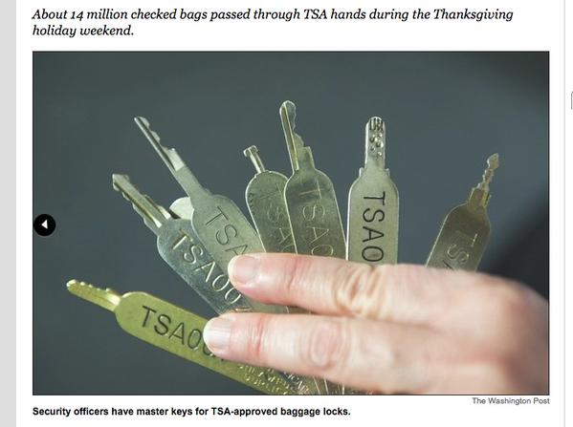
Travel Sentry key compromise
Travel Sentry and the TSA are bad at data classification and key escrow security.
2011
©Ryetronics on Instagram
2014
©Scott Mayerowitz @GlobeTrotScott
2014
The Washington Post
Notes:
Stupid Q: Was this WaPo?
-Yes

Slide 13
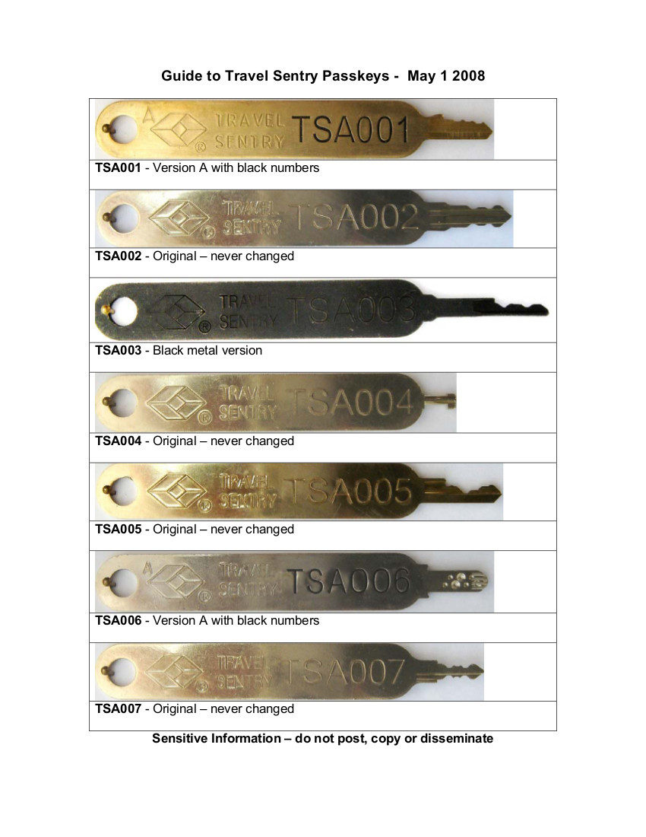
Travel Sentry key compromise
Travel Sentry and the TSA are bad at data classification and key escrow security.
2011
©Ryetronics on Instagram
2014
2014
Notes:
Image covers the “We be key dumbz” title.
Source of this image: TSA or TS?
-TS, formerly found at https://www.travelsentry.org/security/pdf/Guide_to_TravelSentry_Passkeys_1_October_2012-EN.pdf

Slide 14
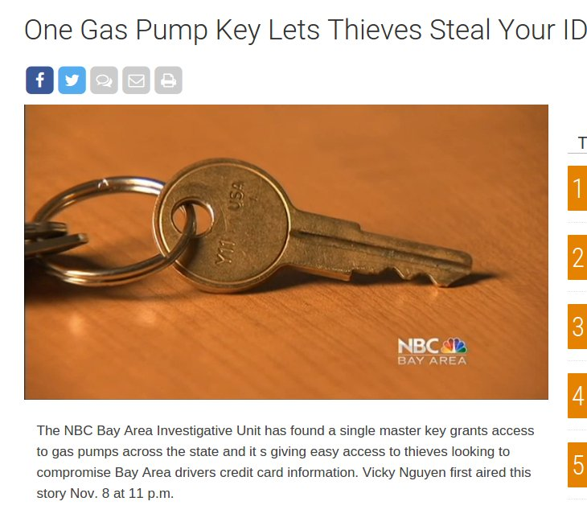
Travel Sentry key compromise
Travel Sentry and the TSA are bad at data classification and key escrow security.
2011
©Ryetronics on Instagram
2014
2014
Notes:
Image covers the “We be key dumbz” title.
Source of this image: TSA or TS?
-TS, formerly found at https://www.travelsentry.org/security/pdf/Guide_to_TravelSentry_Passkeys_1_October_2012-EN.pdf

Slide 15
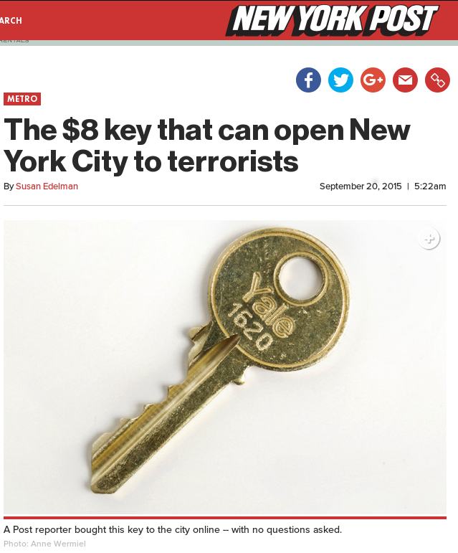
Travel Sentry key compromise
Travel Sentry and the TSA are bad at data classification and key escrow security.
2011
©Ryetronics on Instagram
2014
2014
Notes:
Image covers the “We be key dumbz” title.
Source of this image: TSA or TS?
-TS, formerly found at https://www.travelsentry.org/security/pdf/Guide_to_TravelSentry_Passkeys_1_October_2012-EN.pdf

Slide 16
Travel Sentry key compromise
Travel Sentry and the TSA are bad at data classification and key escrow security.
Real Bad.
And yet you did exactly that.
*** They left it at https://www.travelsentry.org/security/pdf/Guide_to_TravelSentry_Passkeys_1_October_2012-EN.pdf and didn’t notice for months. ***
Notes:
I wonder… can we zoom in using some animation of some sort?
“Unchanged” keys? (Really?!) After how many years?
Jab at “it’s the fine print”?

Slide 17
Photos aren’t the same as handing out keys, right?
Oops, nope. Just as bad if not worse. (You can’t email a physical object)
Researchers in academia and the security community have been warning about key duplication from photos for years
At least two business (Key.me and Keysduplicated.com) offer this as their primary service
TOOOL.nl and others have even demonstrated using this technique for High Security keys and locks
“Showing Keys in Public - What Could Possibly Go Wrong?” Jos Weyers, HOPE X, July 19, 2014
“Copying keys from photos is child's play” The Guardian, November 14, 2008 (Sneakey project)
“Methods of Copying High Security Keys” Barry Wels and Han Fey, The Last HOPE, July 19, 2008
AutoKey3D (formerly PhotoBump) Presented at LockCon 2014 and released on GitHub by Christian Holler (https://github.com/choller/autokey3d)
Notes:
“What’s the problem with a picture?”
Legit Q. Say what *could* be done; later we say what *was* done; then you shoyld add a slide that’ll kick ‘em in the keyway - remind them the “bad guys” are *actively* looking to undermine the locks for their own gain (almost always at the owner’s expense)
...whereas you, Toool, et al, are the “lowest energy state” of coördination, effort, and are comparatively harmless (interest in contents vs interest in just the lock).
That oughtta scare the biaxials outta the audience.
(Does “Mastering Master-Keyed Systems” from HOPE #9 cover this?)

Slide 18
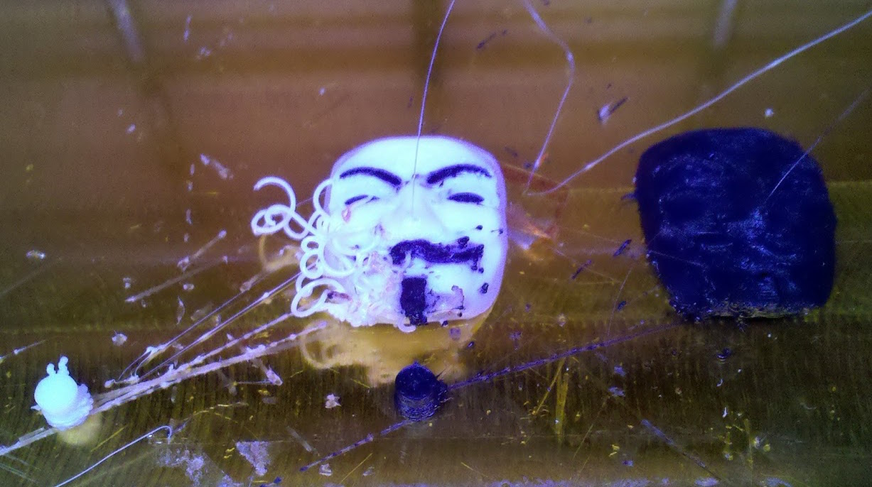
“Fun” with 3D Printing

Slide 19
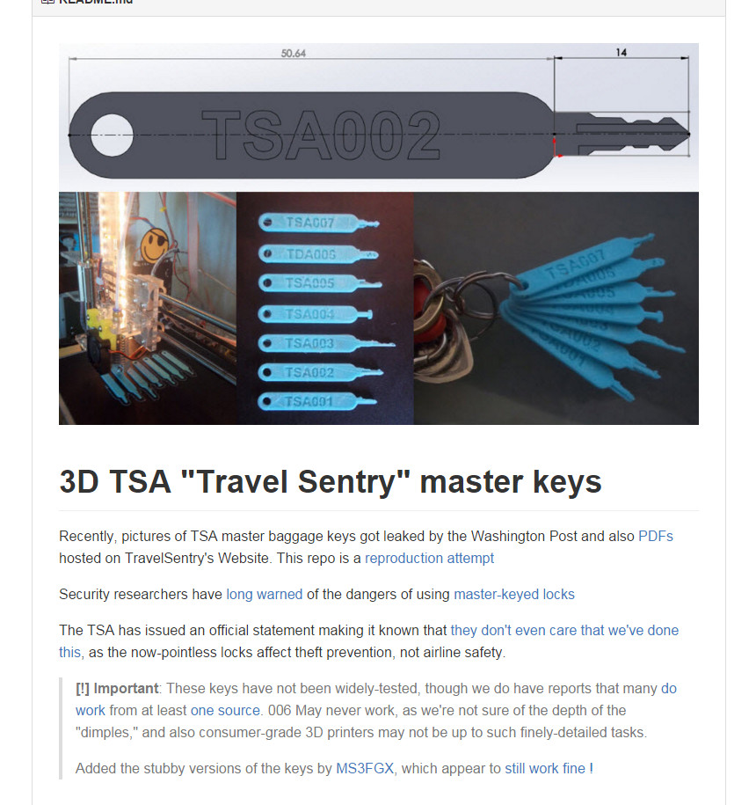
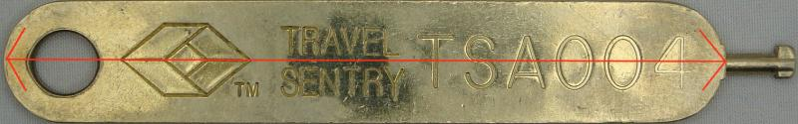
The “Fun:”
@DarkSim905, @Xylit01, MS3FGX, @J0hnnyXm4s
Take images
Raytrace
3D CAD
3D print those suckers and test
Refine, reiterate
GitHub!
Refine, reiterate
Notes:
Describe the process used by DarkSim, et al. to make the 3D-printed keys
I wonder if we can get screenshots of tweets - pile them up like the key pix…. if time permits.
<Highlight the “TSA doesn't care” in the pic! add slide reading “Either take security seriously or your security will be seriously taken from you”.>

Slide 20
3D Printing keys is a really dumb idea
Torsion strength of materials is often less than is necessary
Even when they do work, you rarely get more than a few uses out of a single key
Materials expand / contract while cooling, resulting in a final product that can deviate significantly from the design
Filing our own metal keys is very easy.

Slide 21
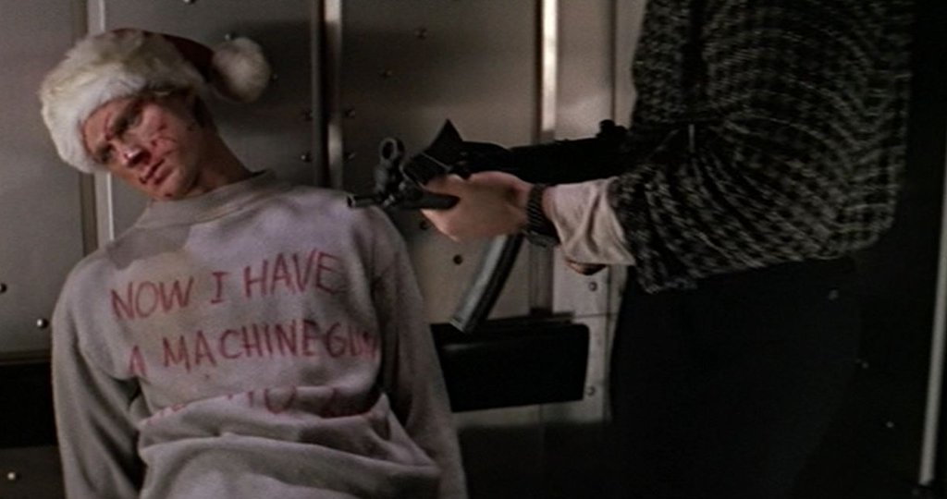
Dealing with the Media

Slide 22
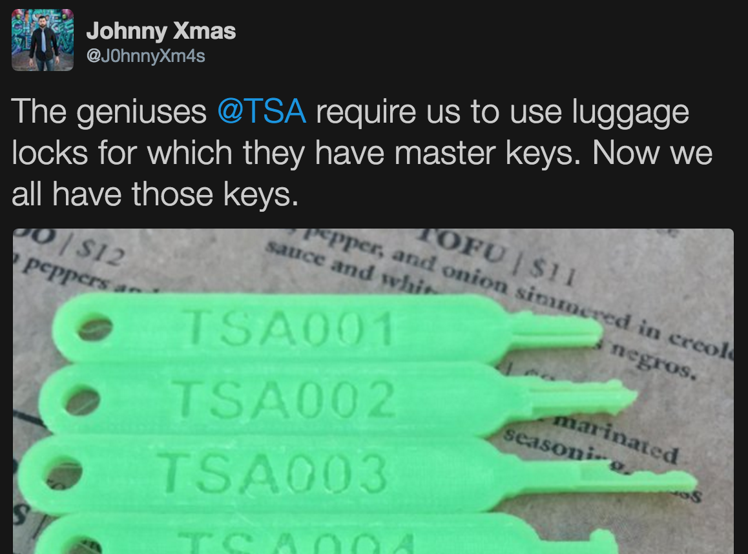
DEALING WITH THE MEDIA
Content is rarely, if ever fact checked.
Most news outlets:
At best are now nothing more than Twitter aggregates
At worst, they are news outlet aggregates
Attempts to contact the “journalists” to have corrections made were almost universally met with radio silence

Slide 23
DEALING WITH THE MEDIA
OK, yes, there are still good journalists who care about presenting a story factually and properly
Brian Krebs (Krebs on Security)
Jenna McLaughlin (The Intercept)
Cory Doctorow (Boing Boing)
Jose Pagliery (CNN Money)
Andy Greenberg (Wired)
Steve Ragan (CSO Online)
Bruce Schneier (Schneier on Security)
Note they’re mostly tech journals, which muggles don’t read :/

Slide 24
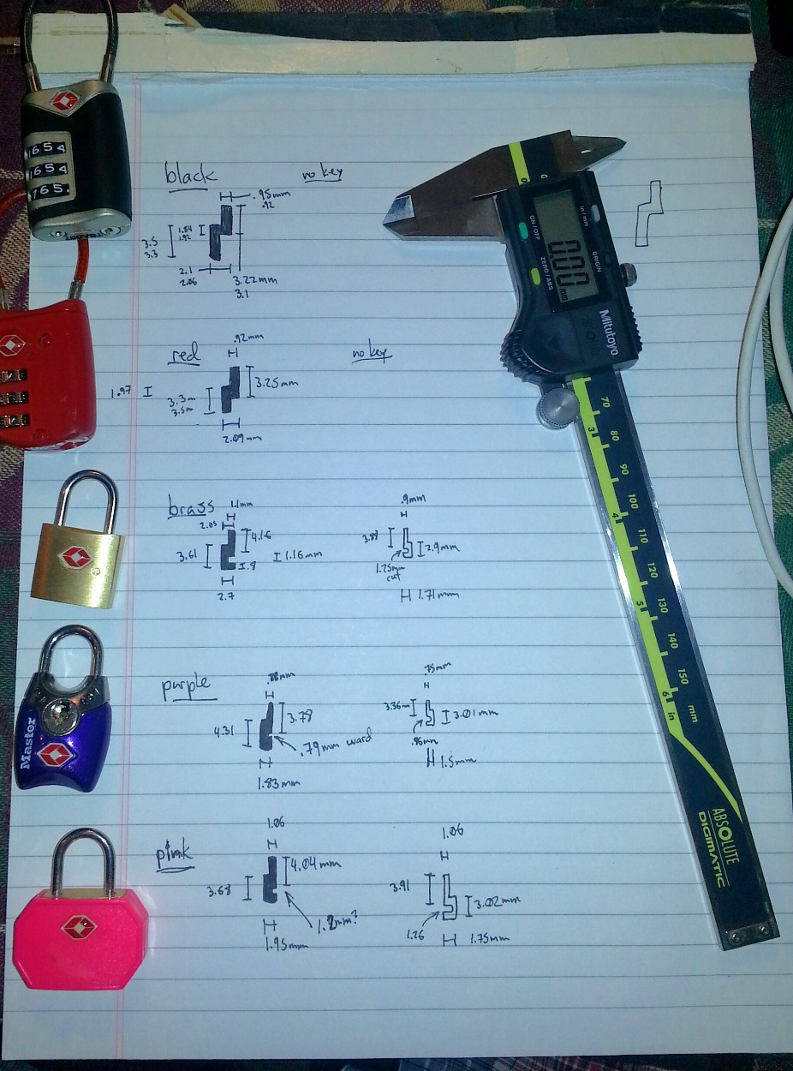
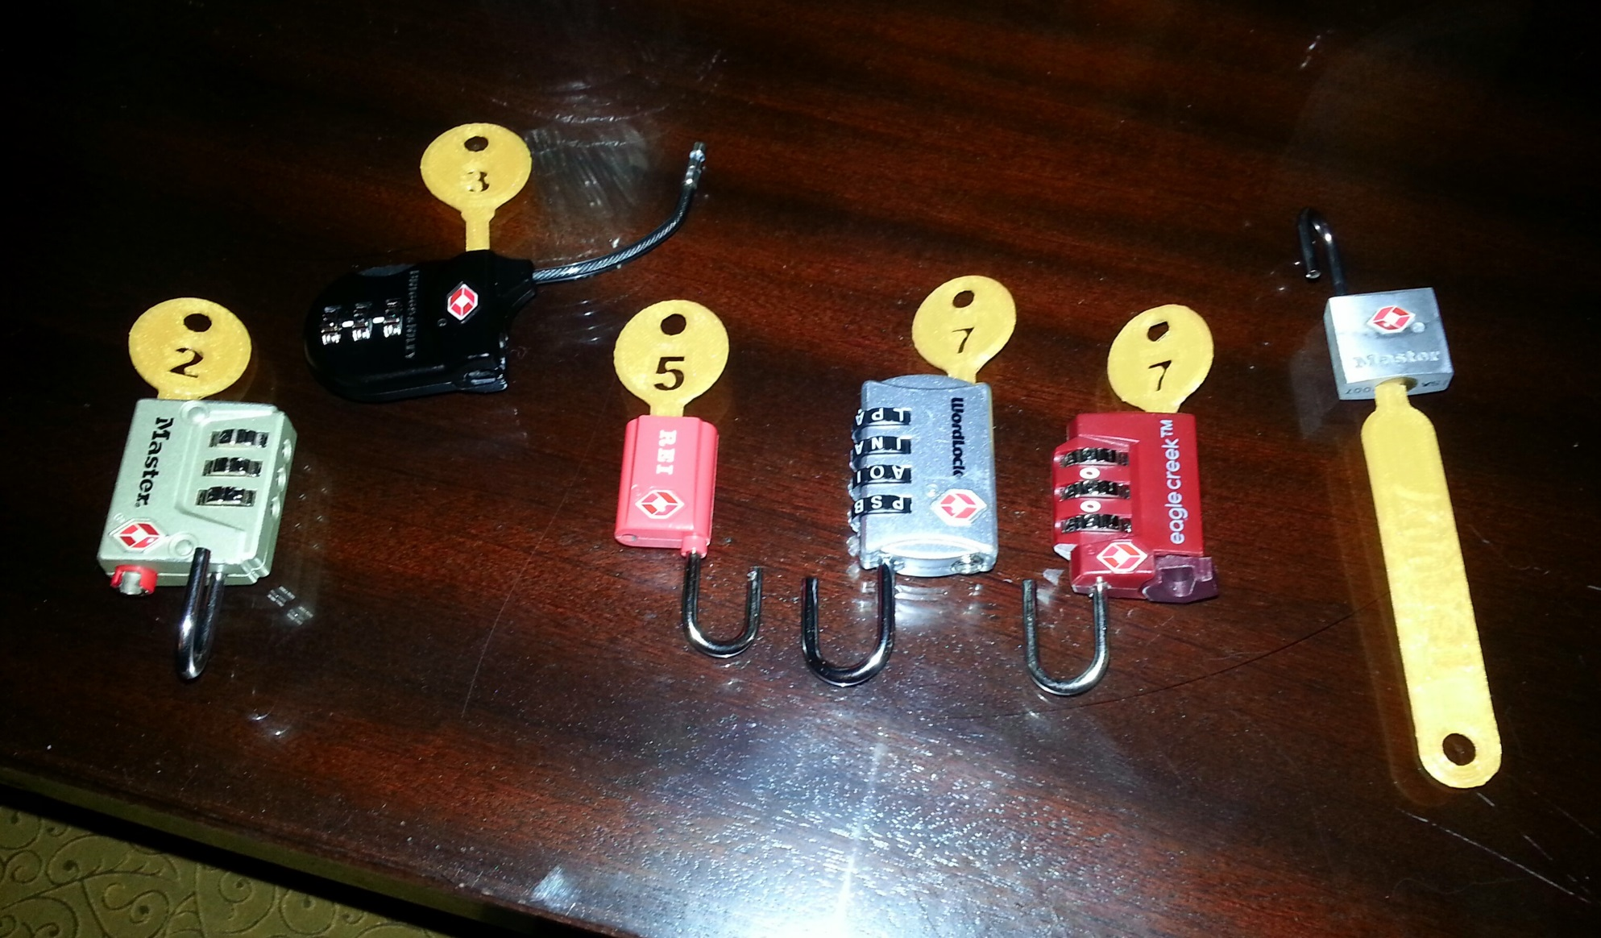
Testing and Refining
Image courtesy Johnny Xmas
Image courtesy Deviant Ollam
Notes:
Examples of the testing process and some of the work that goes into refining the keys when they are a bit off

Slide 25
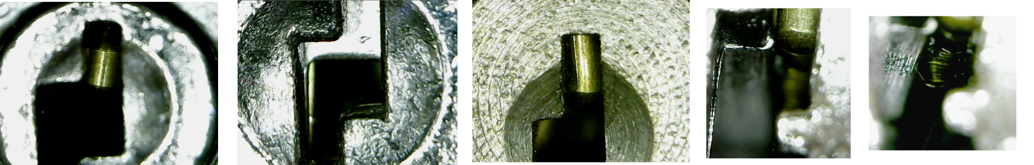
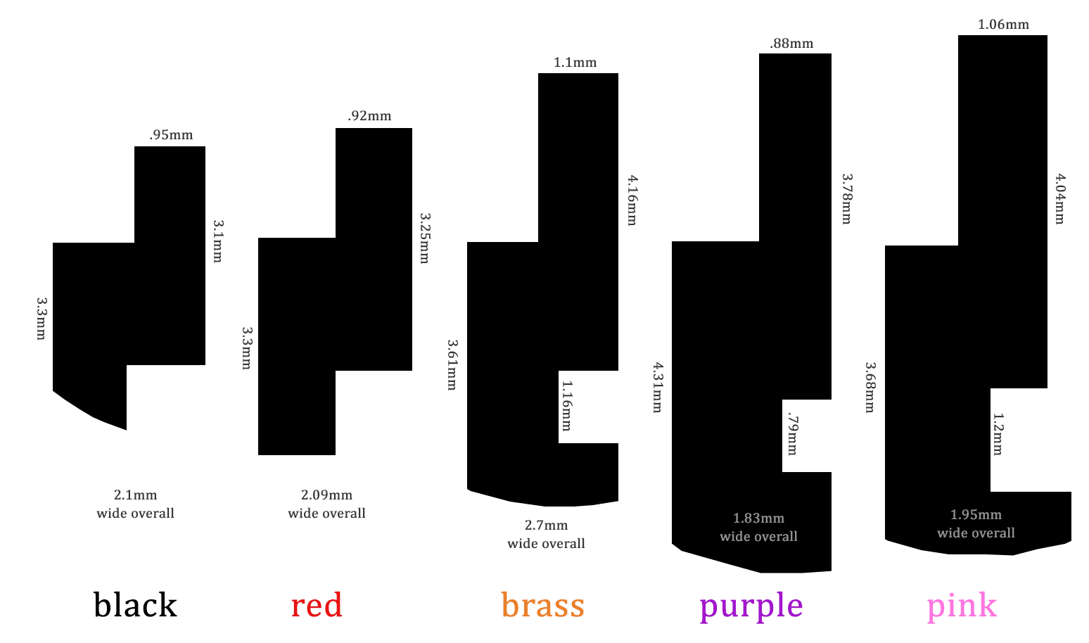
A comparison of TSA007 keyways and mechanisms showing the varying dimensions and mechanisms between designs
Images courtesy The CORE Group and Deviant Ollam
See http://enterthecore.net/tsa007/
Notes:
These photos were taken by members of The CORE Group as part of their effort to refine the model of the TSA007 key.
The important points to note though are the varying dimensions and shapes of the keyways and the different mechanisms being used in different designs across manufacturers.
Not that the width of the main upright section of the keyway varies from 0.88mm to 1.1mm while the height of that section varies from 3.1mm to 4.16mm
Overall heights and widths also vary significantly.
In the end what is necessary for a key to work across multiple keyways is that it is small enough to fit the most restrictive dimensions of any keyway it is supposed to fit while still being able to lift the pins or wafers to the correct height.

Slide 26
Rogue Keys, Mock-ups, Impressioning, and Decoding

Slide 27
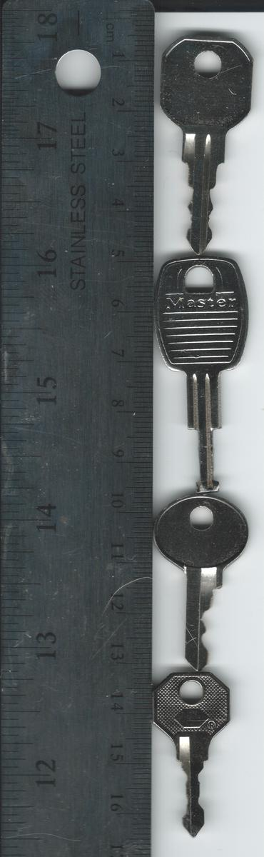
So, nothing left to do, right?
Not quite. Remember, two competing standards? Only one compromised by leaked images and docs. Also not everyone has a 3D printer or the cash to buy printer time from Shapeways.
So what do we do? Fall back on century old techniques:
ID and source compatible blanks (or modify ‘user’ keys)
Impression the hell out of some locks
Adopt, adapt, improve.
Notes:
(Make sure to mention IronGeek’s efforts to derive hand and machine cut keys from images)
From top:
TSA-002
TSA-004
TSA-00? (single-sided 007?)
TSA-007

Slide 28
No Safe Skies, you can’t feel smug either
First, we need key blanks.
What if we can’t find them? We make our own.
The easy way: sheet styrene from a hobby shop and some glue
The hard way: find a blank that is close and introduce it to a Dremel tool
Notes:
(Need process images)

Slide 29
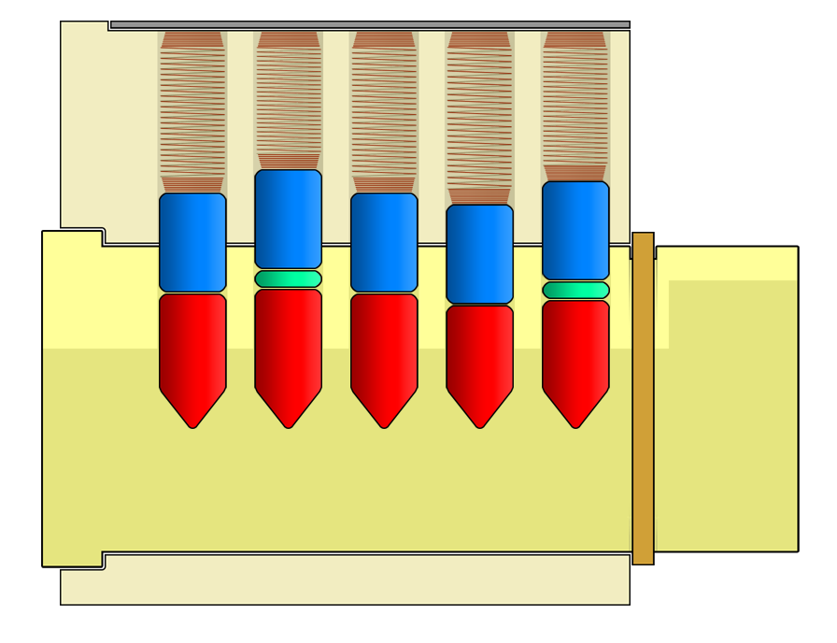
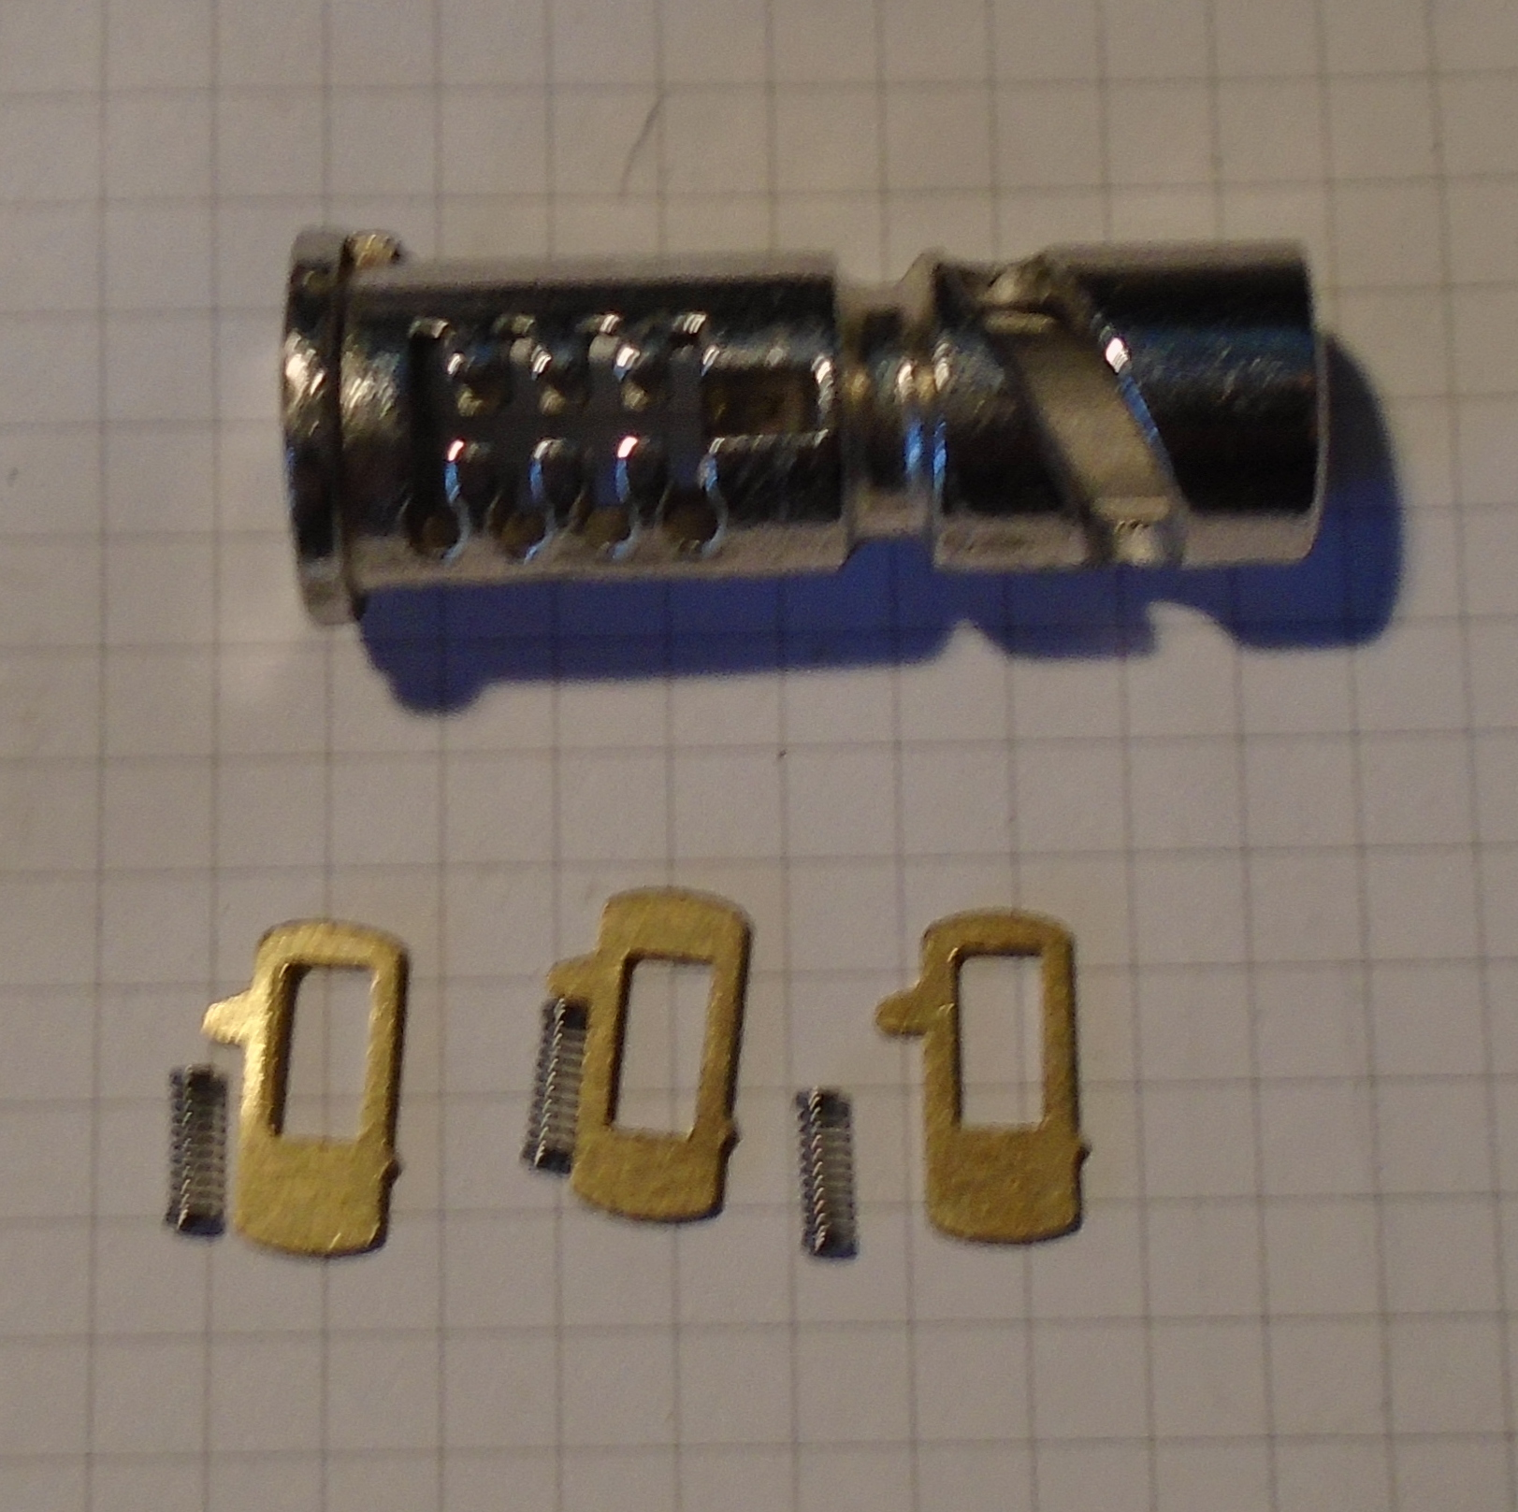
No Safe Skies, you can’t feel smug either
Okay we have our blanks but this is going to be a long brute force slog right?
Safe Skies committed the one of the cardinal sins of key security.
They used a single key for both master keyed and non-master keyed locks.
Big difference in complexity
Image by Deviant Ollam
Notes:
Normally Master Key Escalation attacks require detailed knowledge of the underlying design and pinning system.
Impressioning requires easy access to blanks.
Either system still does not give us 100% certainty that we have derived the true Master Key without either a staggeringly massive sample size or eventual verification against an original Master Key.
This is complicated by the fact that Safe Skies appears to use a TPP (Total Position Progression) system for mastering which ensures no change key ever has a Master key depth cut.
Safe Skies gave us an easy workaround by using the same key for completely unmastered wafer locks.
By simply collecting a handful of unmastered wafer locks so that we have every wafer (Safe Skies often leaves out one pin-stack or wafer) we have a simple and reliable source for measurements and testing.

Slide 30







Master Keying
A regular pin-tumbler lock only has a pair of pins in each chamber which creates only one possible key.
Adding more pins to each stack creates extra possible keys.
1 master pin = 2 keys
2 master pins = 4 keys
3 master pins = 8 keys
4 master pins = 16 keys
and so on following the formula of 2^x where x is the number of master pins
Images courtesy David Knauer
Notes:
Need to work on this math especially when you start adding multiple master pins per chamber

Slide 31
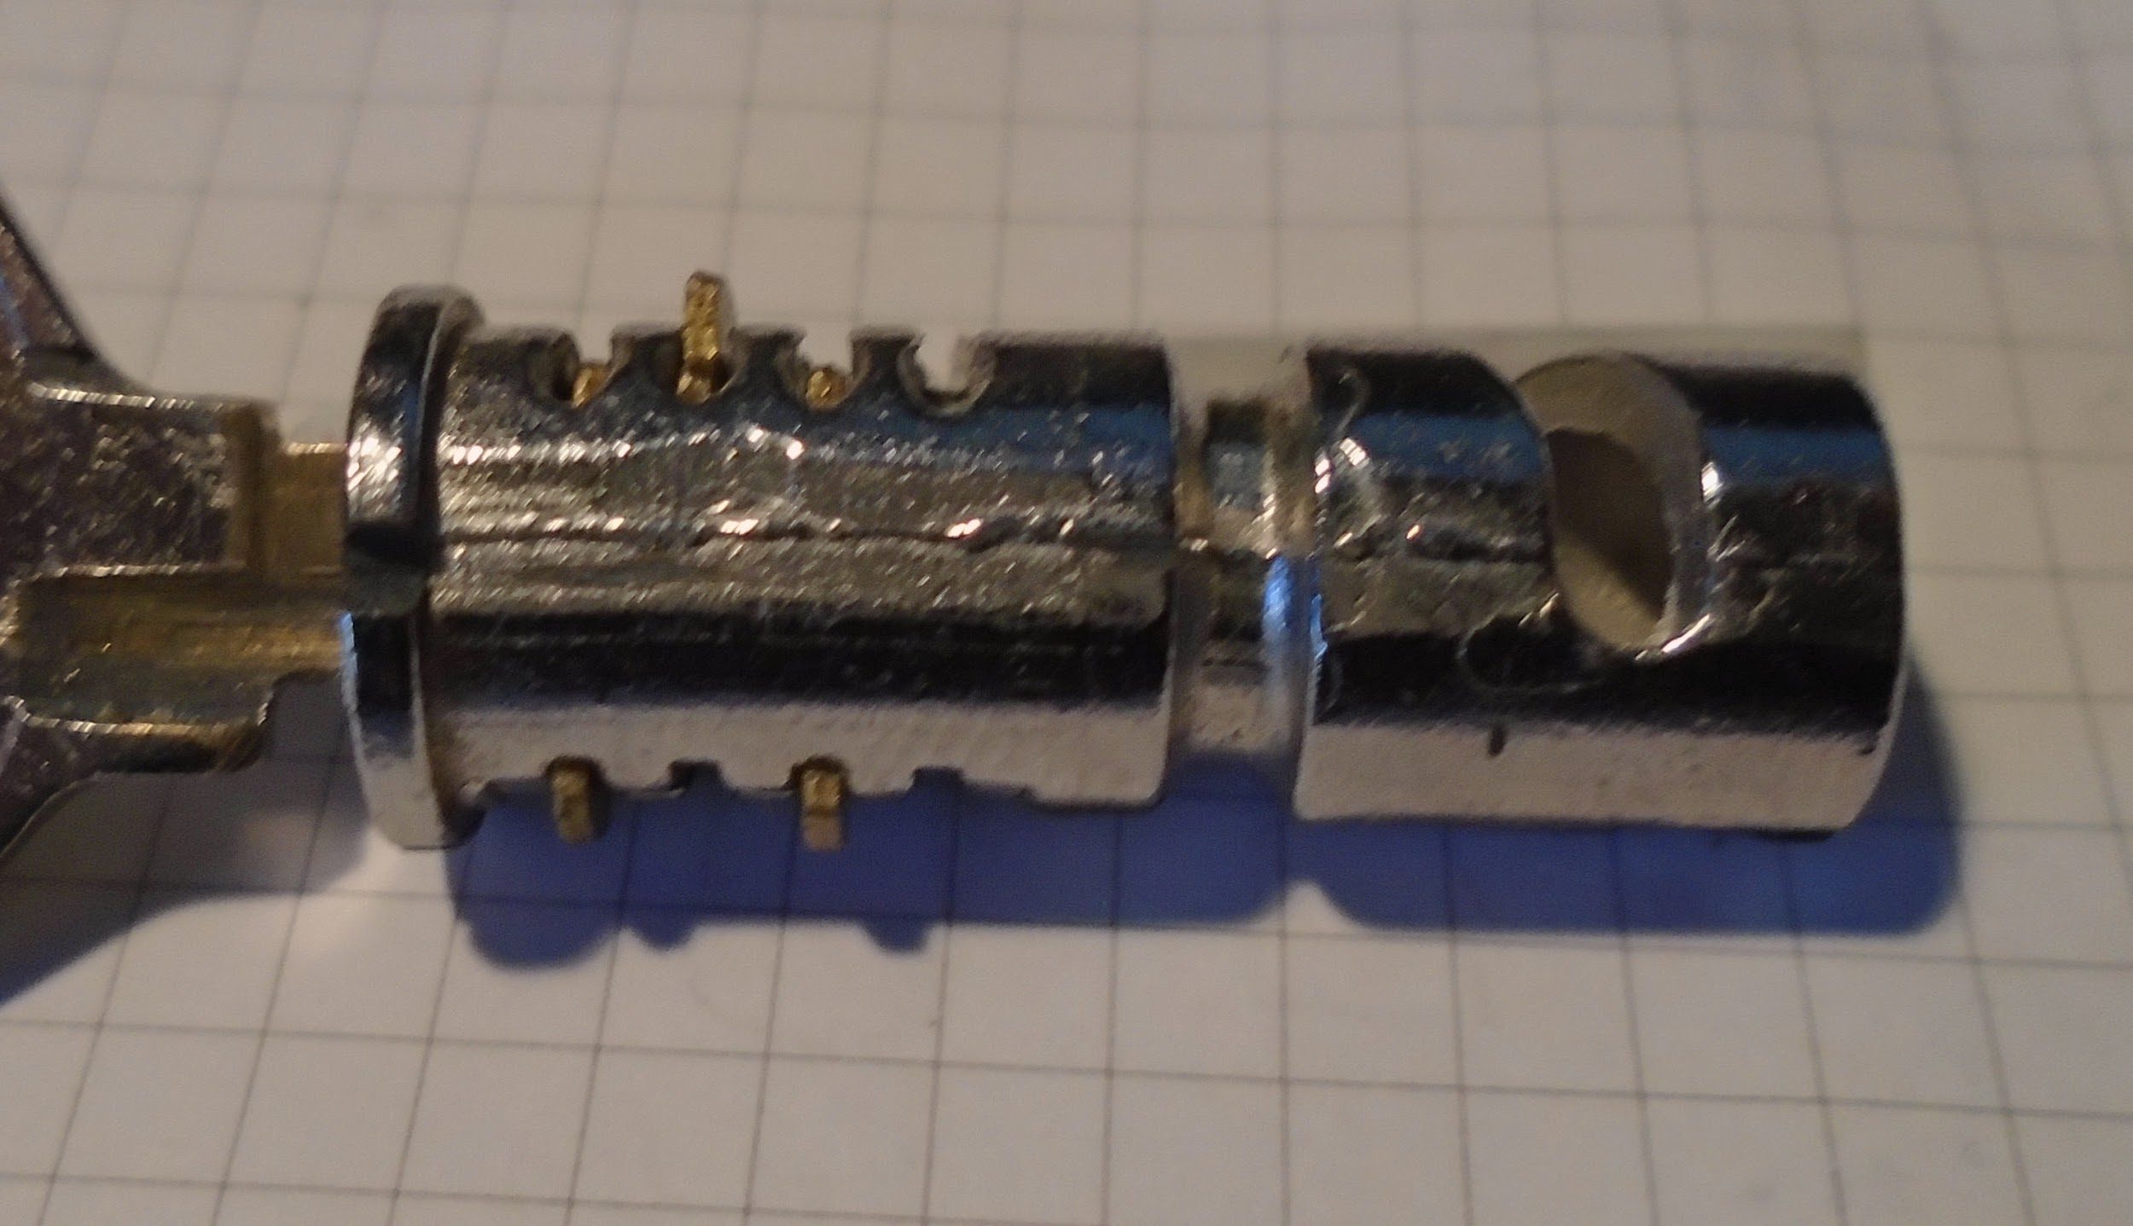
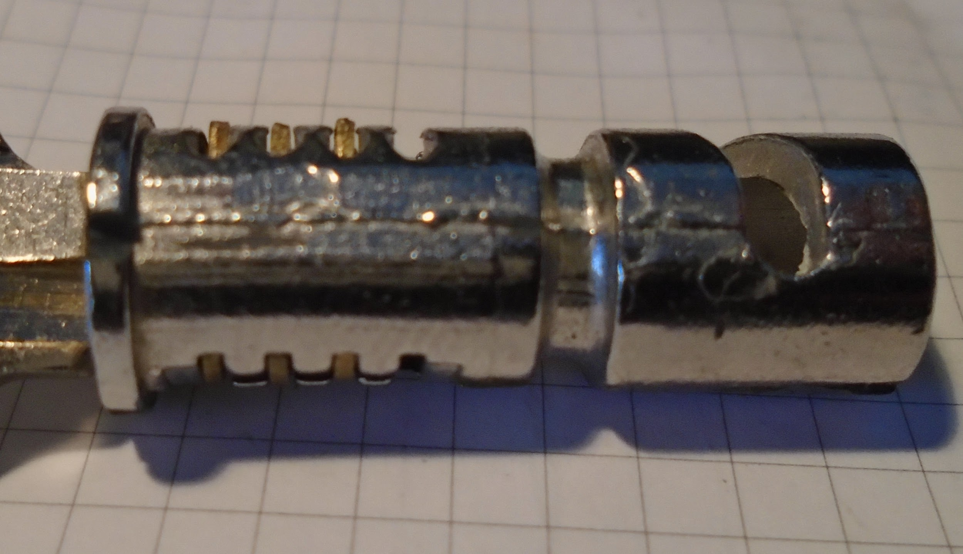
No Safe Skies, you can’t feel smug either
Physical access with no monitoring means we can get messy.
Take non-mastered lock, introduce a Dremel tool
Remove override cylinder
Decode and fit homemade blanks
???
Exploit!
Notes:
[needs more process photos.]

Slide 32
What does the TSA think?
“The reported ability to create keys for TSA-approved suitcase locks from a digital image does not create a threat to aviation security. These consumer products are “peace of mind” devices, not part of TSA’s aviation security regime. Carried and checked bags are subject to the TSA’s electronic screening and manual inspection. In addition, the reported availability of keys to unauthorized persons causes no loss of physical security to bags while they are under TSA control. In fact, the vast majority of bags are not locked when checked in prior to flight.”
-TSA spokesperson Mike England
https://theintercept.com/2015/09/16/tsa-doesnt-really-care-luggage-locks-hacked/
Notes:
Describe the process used by DarkSim, et al. to make the 3D-printed keys
I wonder if we can get screenshots of tweets - pile them up like the key pix…. if time permits.
<Highlight the “TSA doesn't care” in the pic! add slide reading “Either take security seriously or your security will be seriously taken from you”.>

Slide 33
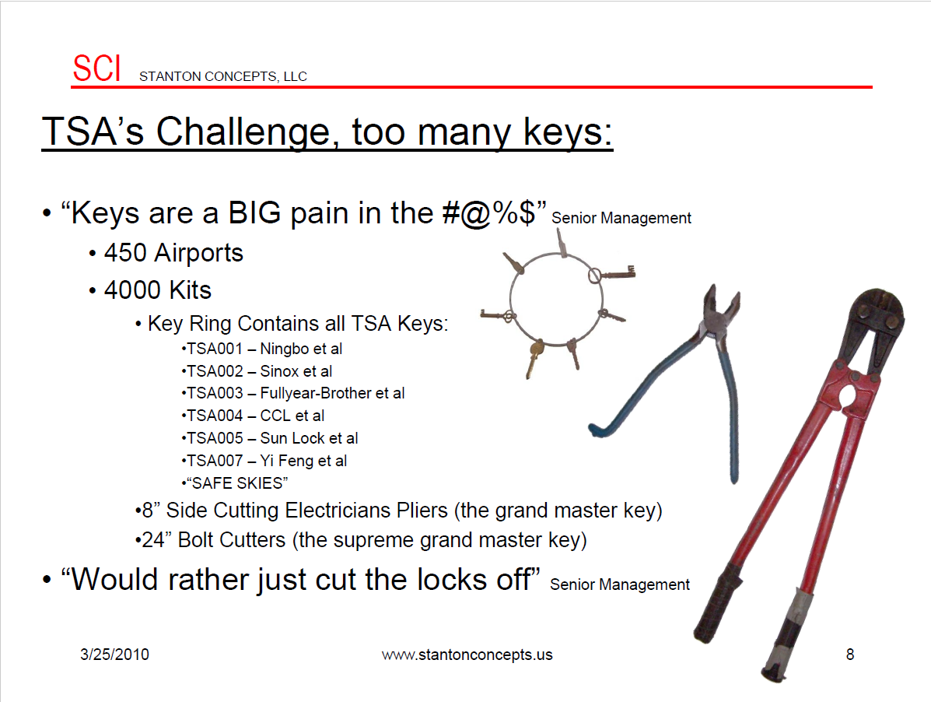
Future Systems (Stanton Concepts Gen 2 proposal)

Slide 34
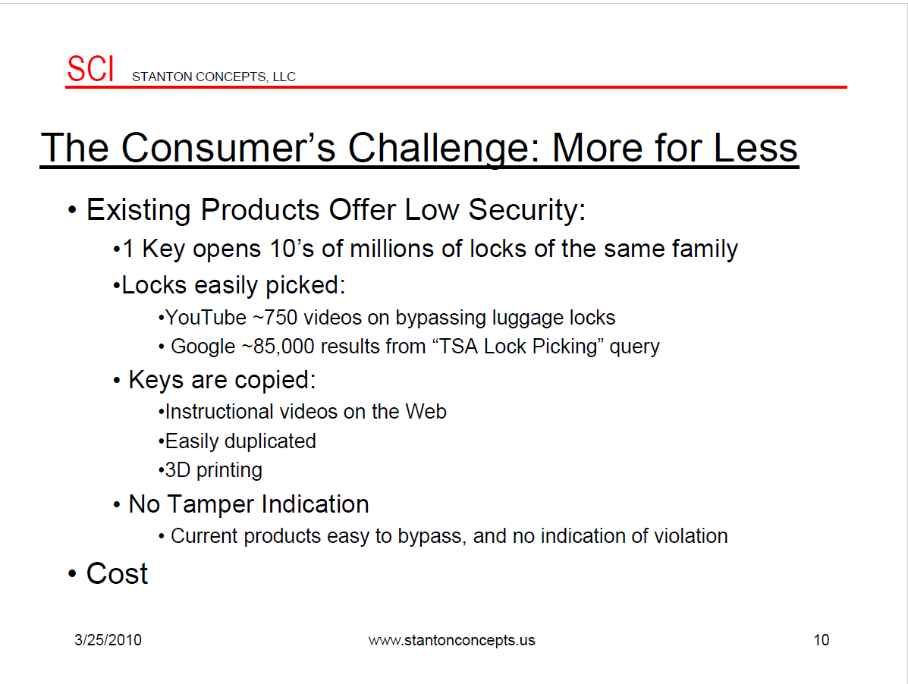
Future Systems (Stanton Concepts Gen 2 proposal)
SCI recognises why the existing system is bad for the traveling public

Slide 35
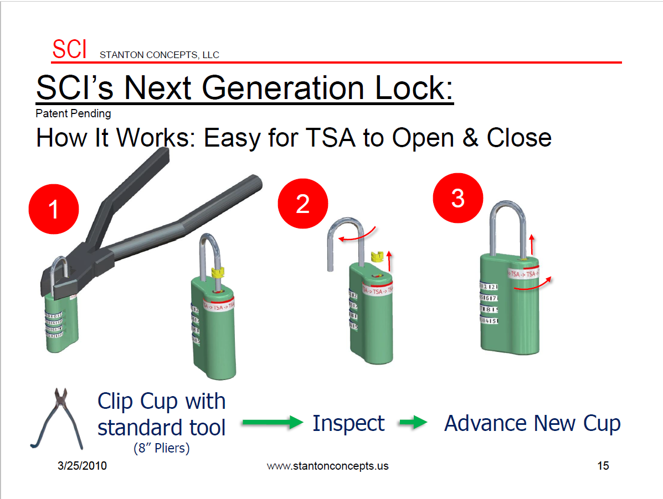
Future Systems (Stanton Concepts Gen 2 proposal)
SCI recognises why the existing system is bad for the traveling public
So they make it worse!

Slide 36
So what now? (for the traveling public)
TSA Approved locks were never secure to begin with and most luggage isn’t either
Remember criminals have had access to these keys or subtle destructive techniques for years
Theft by airline and TSA staff is common and easily hidden
The only real change is that now YOU know
Use tamper evident seals
Remember this every time a government official claims to need more access and authority
Avoid valuable or sensitive items in checked bags. This is the only failsafe.
Notes:
TSA-006 due to its high-tolerance dimple key design is not yet reliably duplicated but it is only a matter of time.
Hard-sided luggage, real locks, not flying, avoiding checking bags
If possible fly with firearms or other materials that are legally required to be packed securely.
Show potential thieves that you are ‘paying attention’ by adding tamper-evident measures like zip-ties, plastic-wrap, etc as deterrent to surreptitious theft.
Very little will protect against thieves covering their theft by covering their acts with false “lost luggage” or “catastrophic damage” (ie conveyor accident that damages bags beyond repair)

Slide 37
So what now? (for the security community)
Use this to explain why Key Escrow crypto systems in government hands are unsafe
Every security system is only as good as its weakest element
You need plans to revoke and replace compromised locks and keys just like CA certs and crypto keys
Don’t trust “black box” security solutions
We need to apply the same peer review and open source philosophy to analysing physical security
Hold government, standards bodies, and manufacturers accountable for their screwups
Notes:
Too many systems have single points of failure or single points of compromise
“Brute-force applies everywhere”

Slide 38
Questions?
(too bad)
@DarkSim905, @J0hnnyXm4s, @nite0wl_2600
With Many thanks to ***Xylit01***, MS3FGX, Irongeek_ADC, Deviant Ollam, David Knauer, PNTinDC, Click, and too many others I can’t name.
Uncredited images are courtesy Nite0wl, DarkSim905, J0hnny Xm4s, David Knauer, Deviant Ollam, and random Google Image search results. No ownership, permission, endorsement, or direct association is intended or implied. Trademarks are property of their respective owners, We are not Lawyers, keep hands and loose clothing clear of moving parts, do not operate heavy machinery while under the influence of this presentation.

Slide 39
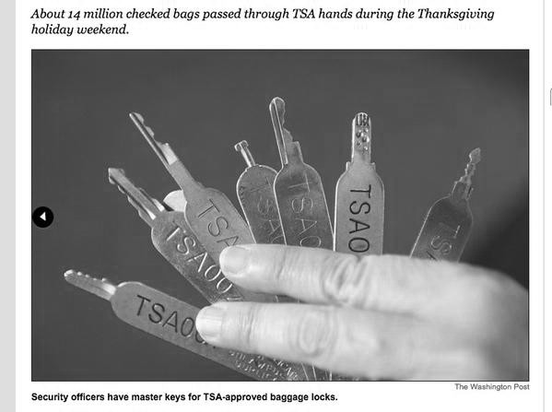
But wait! There is more...

Slide 40
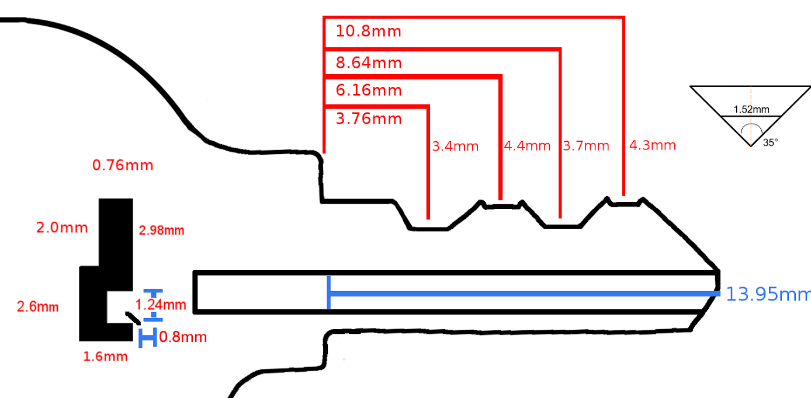
Drop it!

Slide 41
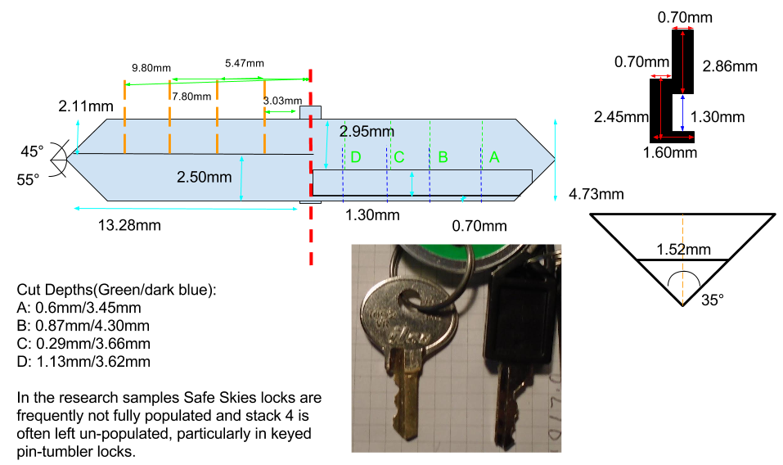
Drop it!

